Slide 1
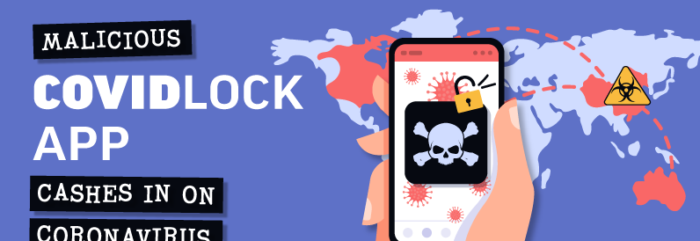
Unveiling CovidLock
A New Threat Exploiting Pandemic Fears

Slide 2
Contents
Introduction
Background
How CovidLock Works
Technical Analysis
Prevention
Conclusion
Limitation

Slide 3
Team Members
Pulok Saha 2019331021
Sourav Bhowmik Joy 2019331037
Niloy Roy 2019331055
Anirban Das Gupto 2019331116

Slide 4

Introduction
CovidLock ransomware emerged during the COVID-19 pandemic.
Disguised as A Coronavirus Tracker app.

Slide 5

Background
CovidLock was first identified in March 2020.
A website named coronavirusapp.site was registered on March 8, 2020.

Slide 6
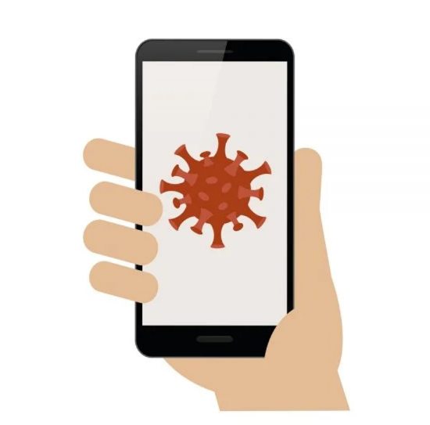
BACKGROUND (Cont.)
The website lures users into downloading an Android application "Coronavirus Tracker."
The app claimed to find any nearby people infected with the coronavirus.

Slide 7
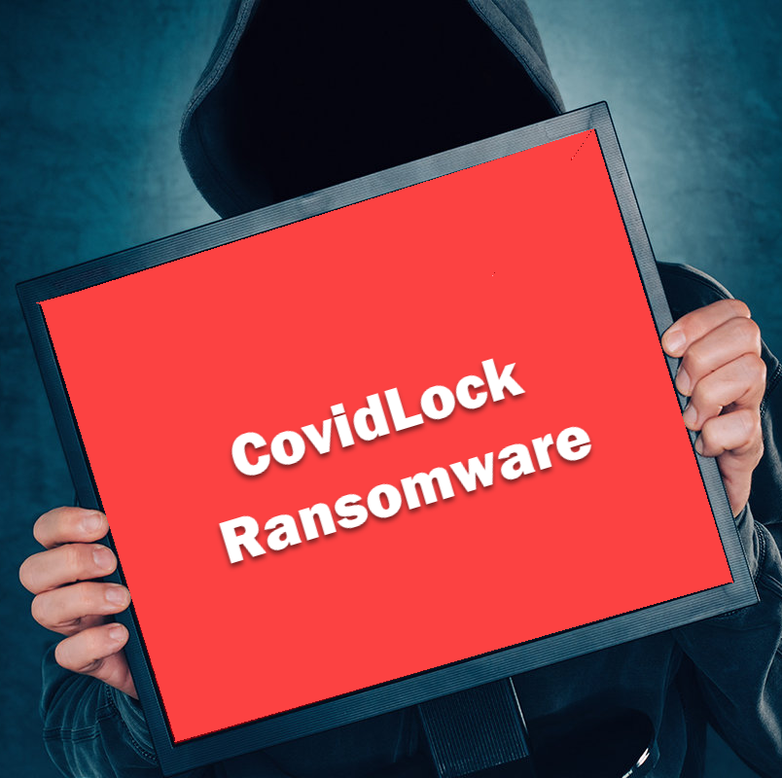
BACKGROUND (Cont.)
But it is not a tracker app as promised.
Instead, it is a file locker malware "Covidlock."

Slide 8
How CovidLock Works
Once an user installs the Coronavirus Tracker app, the ransomware initiates its malicious actions.
As soon as the app starts running, it asks the user to allow it to conduct battery optimization.
Requests battery optimization
8

Slide 9
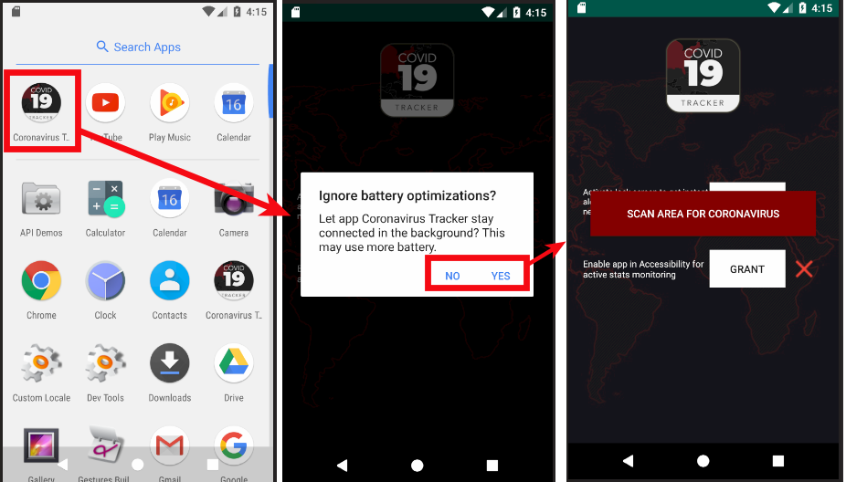
How CovidLock Works
Requests battery optimization
Ransomware does this to keep itself running in the background.
It makes sure that Android does not close the app

Slide 10

How CovidLock Works
After installing, the app requested extensive permissions.
This permissions disguise hidden permissions, including the ability to modify the lock screen password.
Requests Disguised Permissions

Slide 11
How CovidLock Works
Once the initial phase is over, the app requests access to Android’s Accessibility feature
Requests access to Android Accessibility
It is common for attackers to use this functionality to keep the malware persistent

Slide 12
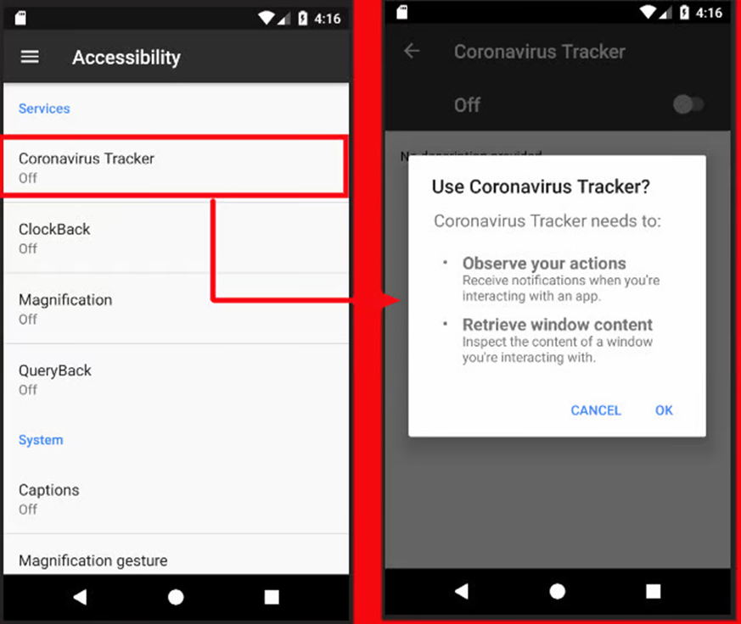
How CovidLock Works
Requests access to Android Accessibility

Slide 13
How CovidLock Works
After the Accessibility request, the app asks for administrator privileges, which should raise a red flag for some users.
Requests admin privileges
Once these permissions/priviledges are granted, the ransomware would change the device’s lock screen password, effectively locking the user out of their device.

Slide 14
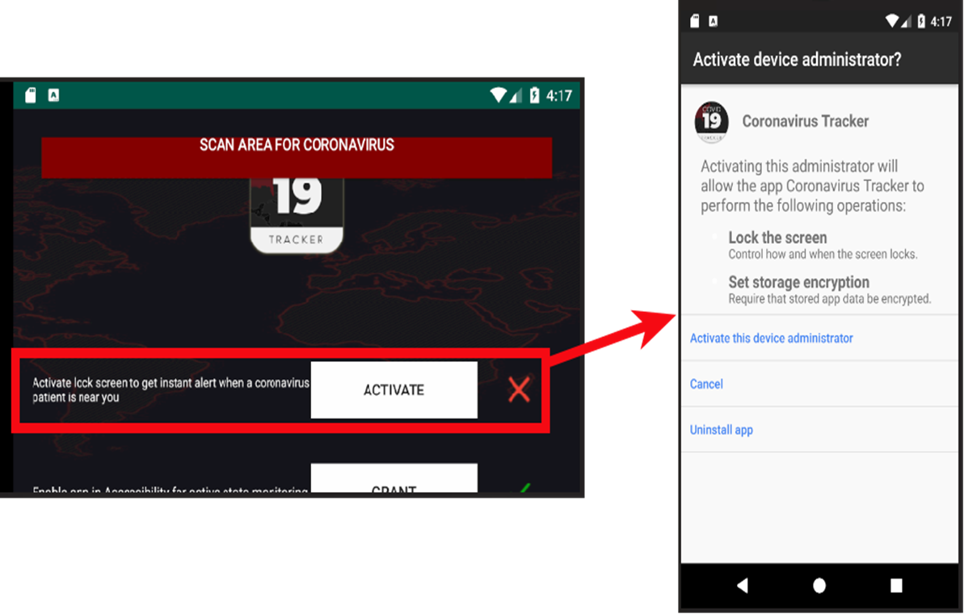
How CovidLock Works
Requests admin privileges

Slide 15
How CovidLock Works
Once admin rights are achieved by the app, the attack is launched.
Ransom Message
As soon as the victim clicks on "Scan Area For Coronavirus," the phone locks itself with a message on the locked screen.

Slide 16
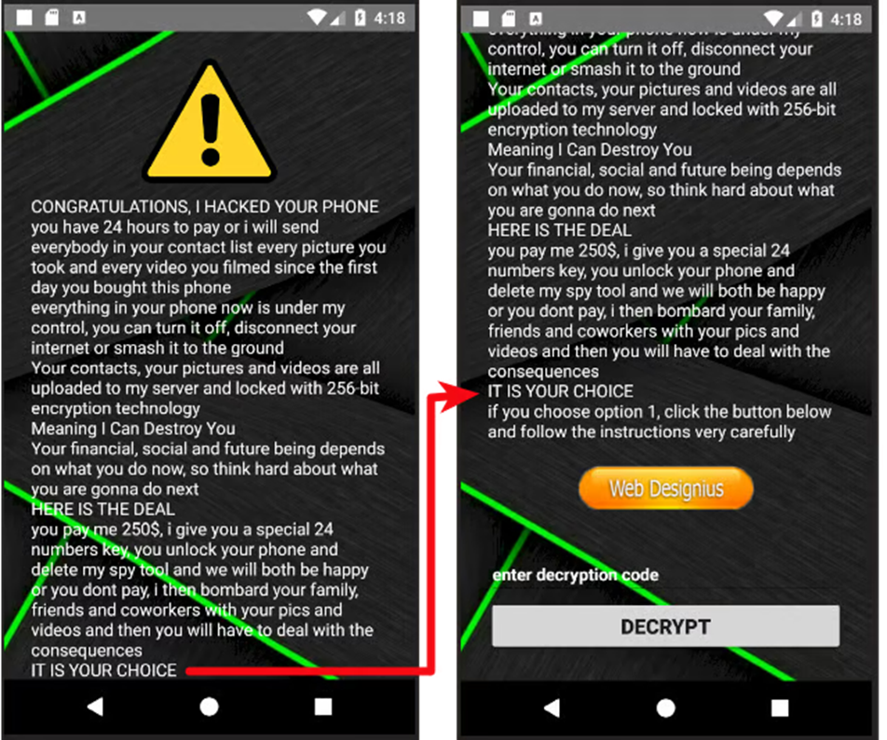
How CovidLock Works
Ransom Message

Slide 17
How CovidLock Works
It asks for $250 as ransom in the form of bitcoins.
Ransom Message
Failure to do so, according to the attacker, can lead to the leaking of the victim's private data, including photos, videos, and more.

Slide 18
How CovidLock Works
The screenshot below shows the steps that need to be performed by the victim to pay the ransom and unlock the device.
Ransom Message
It also shows the bitcoin address and email ID of the attacker.

Slide 19
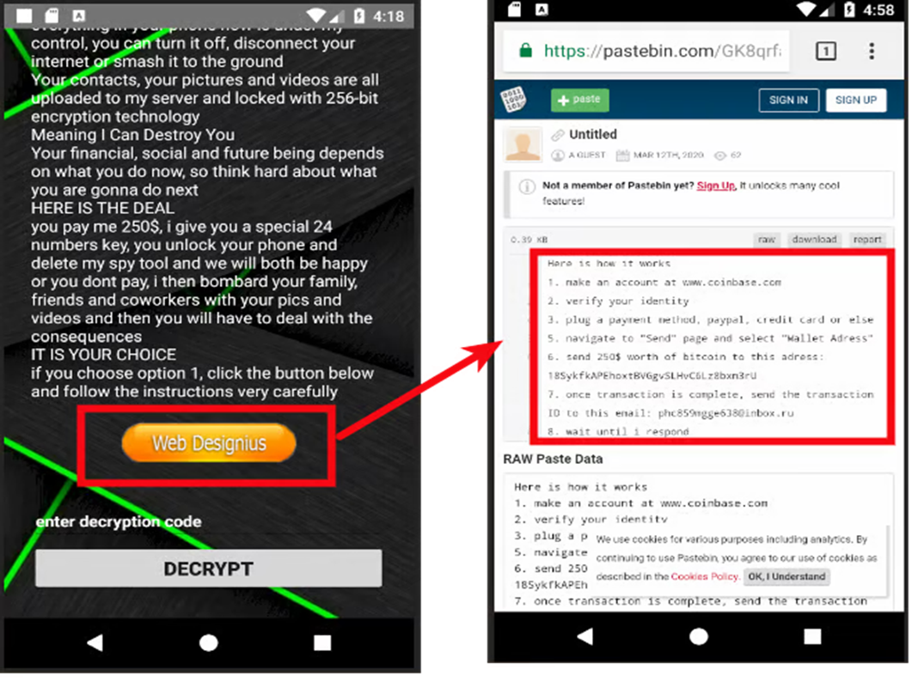
How CovidLock Works
Ransom Message

Slide 20
TECHNICAL ANALYSIS
Looking at the AndroidManifest.xml file of the app, researchers confirmed that the ransomware does not use the internet at all.
Also no traces of internet permissions were found during runtime.
Which means a complete Lack of Internet Access!!!

Slide 21
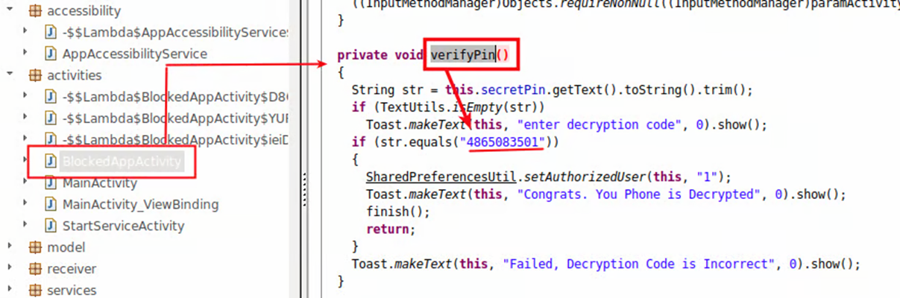
Unlocking Mechanism
Further analysis led to the unlocking functionality where a hard-coded pin to unlock the device was found - 4865083501

Slide 22
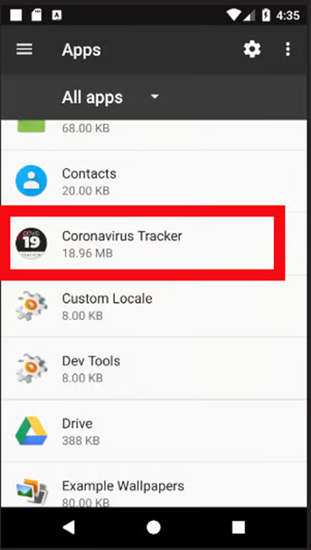
Manual Unlock Routine
Access Device Settings
Navigate to the app list.
Locate "Coronavirus Tracker."

Slide 23
Manual Unlock Routine
Revoke Admin Rights
Disable admin privileges for the app.
Uninstall the App
Remove from the device.

Slide 24
Prevention Tips
Install apps only from official stores like Google Play.
Avoid clicking unknown links in ads, SMS, or emails.
Keep "Unknown Sources" option disabled on Android devices.

Slide 25
Prevention Tips
Ensure your operating system, apps, and antivirus software are up to date.
Enable automatic updates for your operating system and apps to ensure you receive the latest security patches.
Install reputable antivirus or antimalware software that can detect and block ransomware.

Slide 26
Prevention Tips
Perform regular scans of your device to detect any malicious activity.
On Android devices, enable Google Play Protect, which scans apps for malicious behavior.
Be cautious about the permissions you grant to apps. Avoid granting unnecessary permissions.

Slide 27
Limitations of COvidlock
No Data Encryption
Unlike typical ransomware, CovidLock does not encrypt files on the device
Hardcoded Unlock PIN
The unlock code is hardcoded and can be easily found - 4865083501

Slide 28
Limitations of COvidlock
No Internet connection
Lacks internet permissions, so it cannot communicate with a command-and-control server.
Limited Impact
Primarily relies on fear rather than actual technical sophistication

Slide 29
CONCLUSION
In this modern era, it is essential to avoid falling victim to similar attacks. Having a check on regular update of devices and following safe browsing habits is appreciated.

Slide 30
References
CovidLock: Mobile Coronavirus Tracking App Coughs Up Ransomware
CovidLock ransomware exploits coronavirus with malicious Android app
​CovidLock Ransom Walkthrough
CovidLock: Android Ransomware Spreading Amid COVID-19 Epidemic

Slide 31

Thank you

Slide 32
Presentation Video Link
Paste the drive link here

